Slide 1

SOEN 6431 SOFTWARE MAINTENANCE AND EVOLUTION
Dr. Juergen Rilling
Week 7
Configuration Management

Slide 2
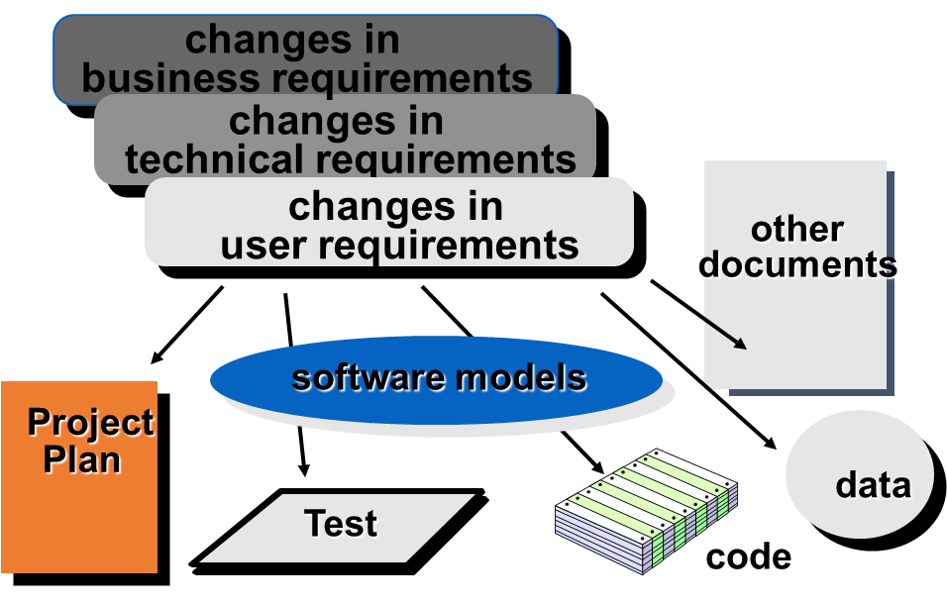
What Are These Changes?

Slide 3
System families

Slide 4
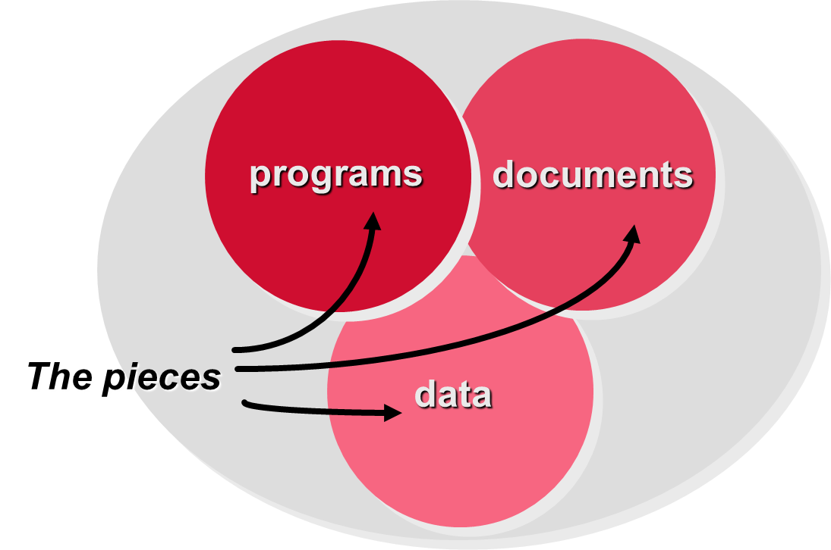
Configuration Management Space
build anywhere, anytime, with correct components
several builds running in parallel
each build can run itself in parallel

Slide 5

Introduction Configuration Management
A way of dealing with changes

Slide 6
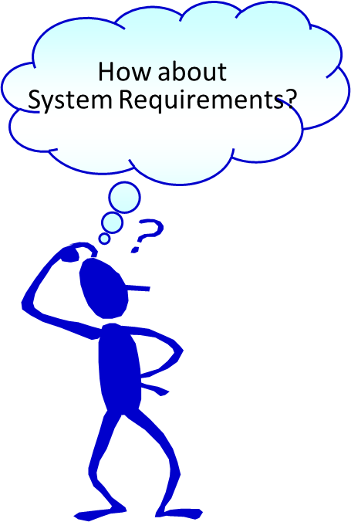
Introduction
Configuration item = “An aggregation of hardware, software, or both that is designated for configuration management and treated as a single entity in the configuration management process.” [CMM , IEEE Std 610]
Configuration item [CMM ]

Slide 7
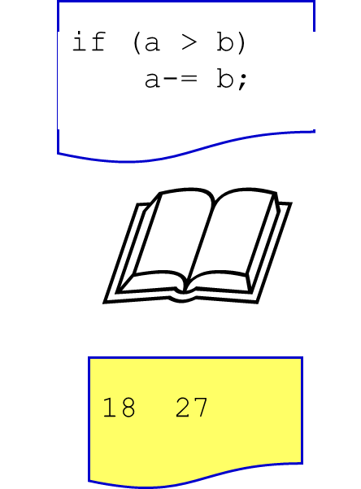
Introduction
Soft. Configuration Item (SCI)
SCI = “Information that is created as part of the software engineering process.” [R.Pressman]
Types of SCIs:
computer programs (source code or exec)
documents (also manuals)
data (e.g. test cases)

Slide 8

Introduction
Name (character string)
Description (SCI type, project identifier, version information, change information)
Resources required by the SCI (e.g. global variables required to compile the module)
Realisation (e.g. a link to a text file)
SCI identification

Slide 9

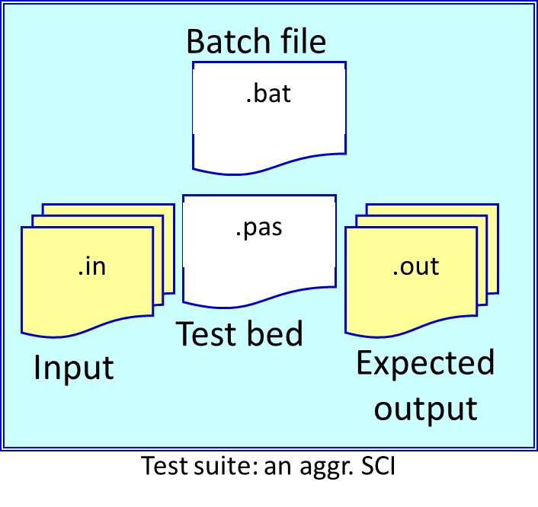
Introduction
SCI can be ...
Basic
Aggregate (composed of basic or aggregate SCIs)

Slide 10
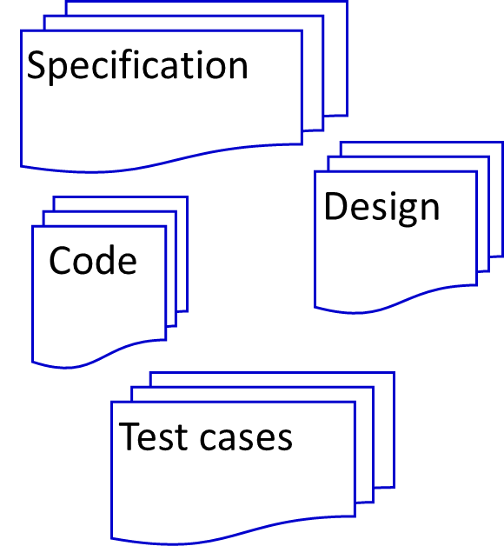
Introduction
Baseline [IEEE 610-1990]
A specification or product that has been formally reviewed and agreed upon,
that thereafter serves as the basis for further development, and
that can be changed only through formal change control procedures.

Slide 11
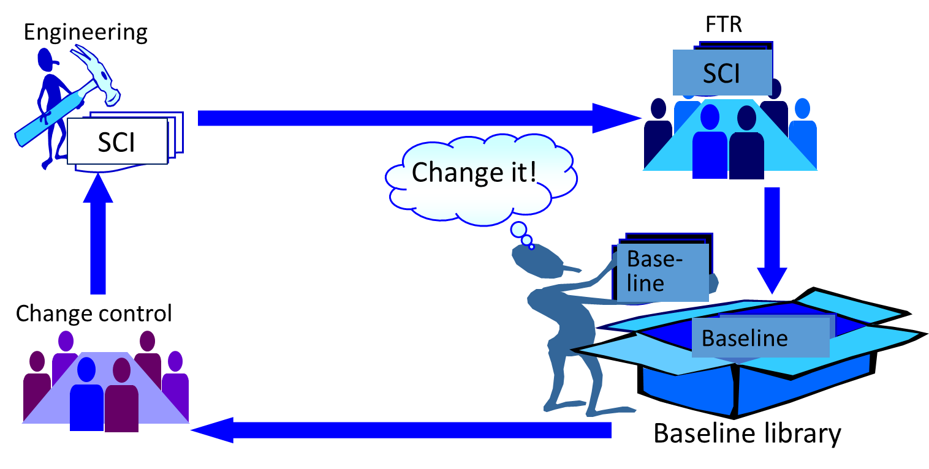
Introduction
Baseline or SCI?

Slide 12
Configuration management
New versions of software systems are created as they change:
For different machines/OS;
Offering different functionality;
Tailored for particular user requirements.
Configuration management is concerned with managing evolving software systems:
System change is a team activity;
CM aims to control the costs and effort involved in making changes to a system.
Involves the development and application of procedures and standards to manage an evolving software product.
CM may be seen as part of a more general quality management process.
When released to CM, software systems are sometimes called baselines as they are a starting point for further development.

Slide 13
SCM Repository
The SCM repository is the set of mechanisms and data structures that allow a software team to manage change in an effective manner
The repository performs or precipitates the following functions [For89]:
Data integrity
Information sharing
Tool integration
Data integration
Methodology enforcement
Document standardization

Slide 14
Repository Content

Slide 15
Repository Features
Versioning.
saves all of these versions to enable effective management of product releases and to permit developers to go back to previous versions
Dependency tracking and change management.
The repository manages a wide variety of relationships among the data elements stored in it.
Requirement's tracing.
Provides the ability to track all the design and construction components and deliverables that result from a specific requirement specification
Configuration management.
Keeps track of a series of configurations representing specific project milestones or production releases. Version management provides the needed versions, and link management keeps track of interdependencies.
Audit trails.
establishes additional information about when, why, and by whom changes are made.

Slide 16
The SCM Process
How does a software team identify the discrete elements of a software configuration?
How does an organization manage the many existing versions of a program (and its documentation) in a manner that will enable change to be accommodated efficiently?
How does an organization control changes before and after software is released to a customer?
Who has responsibility for approving and ranking changes?
How can we ensure that changes have been made properly?
What mechanism is used to appraise others of changes that are made?

Slide 17
The SCM Process
17

Slide 18
The CM plan
Defines the types of documents to be managed and a document naming scheme.
Defines who takes responsibility for the CM procedures and creation of baselines.
Defines policies for change control and version management.
Defines the CM records which must be maintained.
Describes the tools which should be used to assist the CM process and any limitations on their use.
Defines the process of tool use.
Defines the CM database used to record configuration information.
May include information such as the CM of external software, process auditing, etc.

Slide 19
Configuration item identification
Large projects typically produce Thousands of documents which must be uniquely identified.
Some of these documents must be maintained for the lifetime of the software.
Document naming scheme should be defined so that related documents have related names.
A hierarchical scheme with multi-level names is probably the most flexible approach.
PCL-TOOLS/EDIT/FORMS/DISPLAY/AST-INTERFACE/CODE

Slide 20
CM standards
CM should always be based on a set of standards which are applied within an organisation.
Standards should define how items are identified, how changes are controlled and how new versions are managed.
Standards may be based on external CM standards (e.g. IEEE standard for CM).
Some existing standards are based on a waterfall process model - new CM standards are needed for evolutionary development.

Slide 21
Derivation history
This is a record of changes applied to a document or code component.
It should record, in outline, the change made, the rationale for the change, who made the change and when it was implemented.
It may be included as a comment in code. If a standard prologue style is used for the derivation history, tools can process this automatically.

Slide 22
Two Types of Versions:
Revision: A software object that was created by modifying an existing one.
Variant: Two software objects that have an important property in common (e.g., the functional specification, interface), but differ in others (e.g. user interface, platform, algorithms, data structures, user groups).

Slide 23
Version and release management
Invent
Invent an identification scheme for system versions.
Plan
Plan when a new system version is to be produced.
Ensure
Ensure that version management procedures and tools are properly applied.
Plan and distribute
Plan and distribute new system releases.

Slide 24
Version derivation structure

Slide 25
The configuration database
All CM information should be maintained in a configuration database.
This should allow queries about configurations to be answered:
Who has a particular system version?
What platform is required for a particular version?
What versions are affected by a change to component X?
How many reported faults in version T?
The CM database should preferably be linked to the software being managed.

Slide 26
CM database implementation
May be part of an integrated environment to support software development. The CM database and the managed documents are all maintained on the same system
CASE tools may be integrated with this so that there is a close relationship between the CASE tools and the CM tools.
More commonly, the CM database is maintained separately as this is cheaper and more flexible.

Slide 27

Release management
Video

Slide 28
Release management
Releases must incorporate changes forced on the system by errors discovered by users and by hardware changes.
They must also incorporate new system functionality.
Release planning is concerned with when to issue a system version as a release.

Slide 29
Release problems
Customer may not want a new release of the system. They may be happy with their current system as the new version may provide unwanted functionality.
Release management should not assume that all previous releases have been accepted. All files required for a release should be re-created when a new release is installed.

Slide 30
System release strategy

Slide 31
Creating Configurations
Three major models:
Composition model: sets of software objects
Change set model: bundles of changes
Long Transaction Model: all changes are isolated into transactions

Slide 32
Creating Configurations: Composition Model (Parts List)
Configuration is a set of software objects (either atoms or other configurations) or version groups.
When version groups appear in a configuration, then version selection is needed.
Best done with rules.

Slide 33
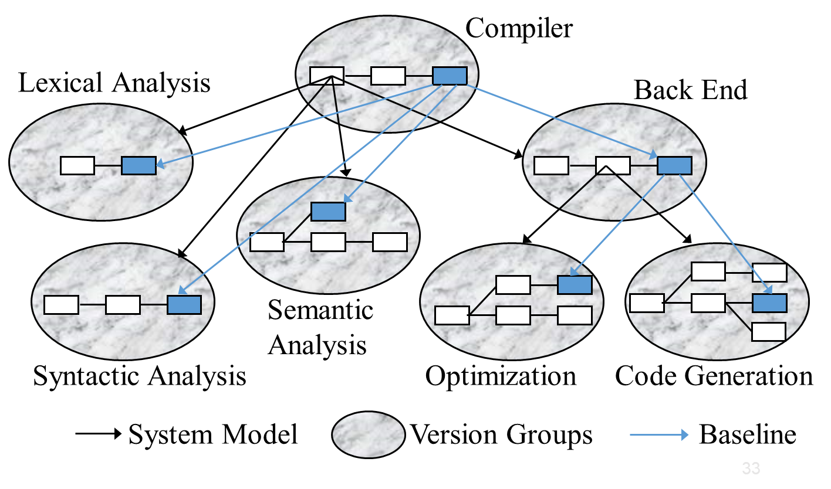
Version Selection

Slide 34
Version selection by rules just a few examples
A
B
C
A’
C’
A’’
C’’
A’’’
A
B
C
1. Baseline: no versions, no selection needed
2. Developer:
select all version checked out by me (e.g. “B”),
+ the newest revision on main branch for others.
3. Cautious Developer:
select last baseline
+ all version checked out by me (e.g. B)
+ all versions checked in by me. (e.g., C’ has been previously checked in by me)
A’’’
B
C’’
A’’’
B
C’

Slide 35
Version selection by rules
A
B
C
A’
C’
A’’
C’’
C’’ ^{Linux}
A’’’
4. Maintainer:
select latest released baseline (e.g.; )
+ all versions checked out by me (e.g. B)
+ newest versions on corrective branches (C’’’)
5. Cautious Maintainer:
select latest released baseline (e.g.; )
+ all versions checked out by me (e.g., B)
+ all versions checked in by me (e.g., A’’’’)
6. Reconfiguration:
select according to 1 through 5
+ variants by attribute (e.g. platform=Unix)
7. Time machine:
select according to 1 through 6
+ ignore everything after a cutoff date
C’’’
A’’
B
C’
A’’’’ ^{Linux}
A’’’’
A’’
B
C’
A
B
C
A’’
C’
A’’’
C’’’
A’’’’ ^{Linux}
C’’ ^{Linux}
A
B
C
A’’
C’
A’’’
A’’’’ ^{Linux}
C’’ ^{Linux}

Slide 36
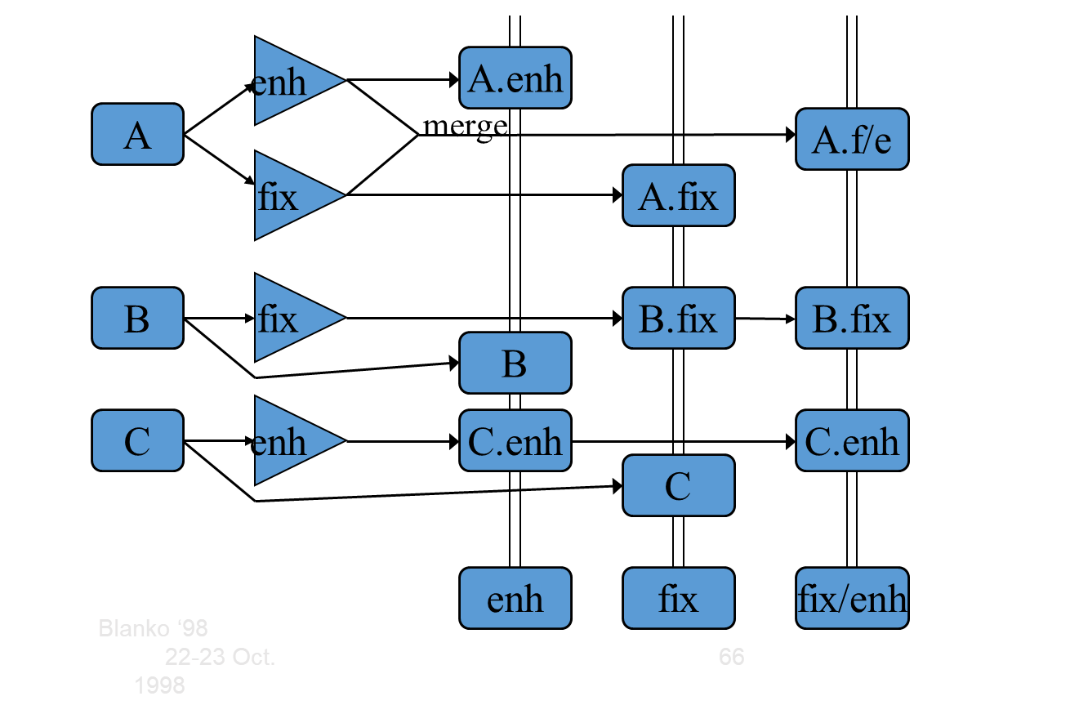
b. Change Set Model
A change set is a set of deltas relative to a baseline.
A new configuration is selected by specifying a baseline and a change set to be applied.
Arbitrary combination of changes is not normally possible, because of change interaction.

Slide 37
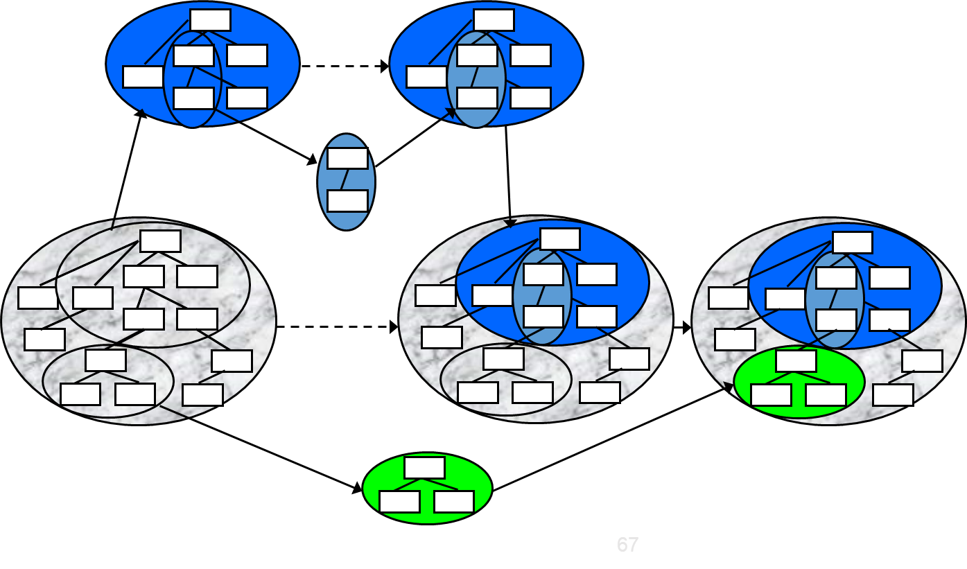
c. Long Transaction Model
Each change happens in a long-running transaction, starting with a configuration.
Sub transactions are started for explorative work.
Versions are not visible except when committing transactions.
Transactions generate workspaces that are completely isolated.
Concurrency control schemes coordinate concurrent transactions.
Locking
Optimistic concurrency control
Long transactions represent workspaces and development paths.
Disadvantage: Concurrency control limits change propagation in the repository.
The long transactions model takes a broader approach by assuming that a system is built up out of logical changes. Its focus is on the coordination and integration of these changes. Basically, it uses versions of configurations and versions of files. A configuration is created based on a change request which is stored separately. Files in this configuration can be synchronized using the check-out/check-in model. When the change is completed, the complete configuration is stored back into the repository and integrated with other changes.

Slide 38
Recent improvements
A. Configuration management on the Web
World-wide accessibility
Rich infrastructure
Platform independence
(Anytime, anywhere configuration mgmt.)
B. Automatic configuration, starting with a small set of software objects.

Slide 39
Release creation
Release creation involves collecting all files and documentation required to create a system release.
Configuration descriptions have to be written for different hardware and installation scripts have to be written.
The specific release must be documented to record exactly what files were used to create it. This allows it to be re-created if necessary.

Slide 40

CM Tool support

Slide 41
CASE tools for configuration management
CM processes are standardised and involve applying pre-defined procedures.
Large amounts of data must be managed.
CASE tool support for CM is therefore essential.
Mature CASE tools to support configuration management are available ranging from stand-alone tools to integrated CM workbenches.

Slide 42
CM workbenches
Open workbenches
Tools for each stage in the CM process are integrated through organisational procedures and scripts. Gives flexibility in tool selection.
Integrated workbenches
Provide whole-process, integrated support for configuration management. More tightly integrated tools so easier to use. However, the cost is less flexibility in the tools used.

Slide 43
Key points
Configuration management is the management of system change to software products.
A formal document naming scheme should be established, and documents should be managed in a database.
The configuration data base should record information about changes and change requests.
A consistent scheme of version identification should be established using version numbers, attributes or change sets.

Slide 44
Key points
System releases include executable code, data, configuration files and documentation.
System building involves assembling components into a system..
CASE tools are available to support all CM activities
CASE tools may be stand-alone tools or may be integrated systems which integrate support for version management, system building and change management.

